Slide 1
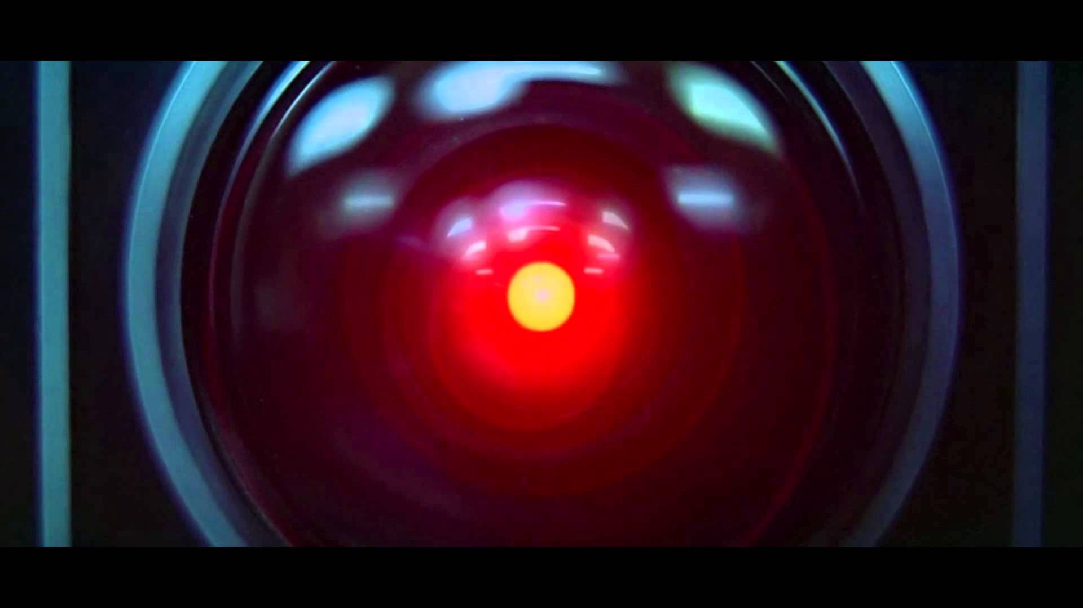
Deep Learning Workshop
Introduction
Instructor: Aaron Low
HELP University, Faculty of Computing and Digital Technology

Slide 2
Workshop Overview
Introduction to Artificial Intelligence
What is Deep Learning?
What is all the fuss?
Deeper Dive into the “Black box”
Have fun!

Slide 3
What is Artificial Intelligence?
Defined as: The study of agents that receive percepts from the environment and perform actions¹
Percepts
Environment
Agent
Action
1: Russell, S. and Norvig, P. Artificial Intelligence: A Modern Approach (3rd Edition). 2010

Slide 4
Brief History of AI
1941: First Program-controlled Computer
1943: Neural Networks
1957: Perceptron
1970: Backpropagation
1979: Convolutional Neural Network
1982: Recurrent Neural Network
1989: Reinforcement Learning
1997: Deep Blue defeats world chess champion Garry Kasparov
2014: Generative Adversarial Networks
2016: AlphaGo beats world Go champion Lee Sedol
2017: AlphaZero
2019: GPT-2
* dates are for perspective, not as definitive historical record of invention or credit

Slide 5
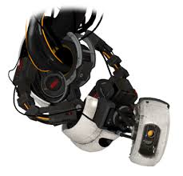
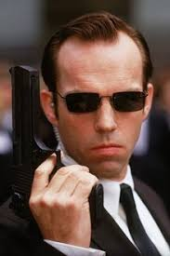
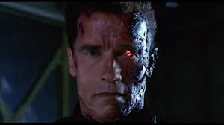
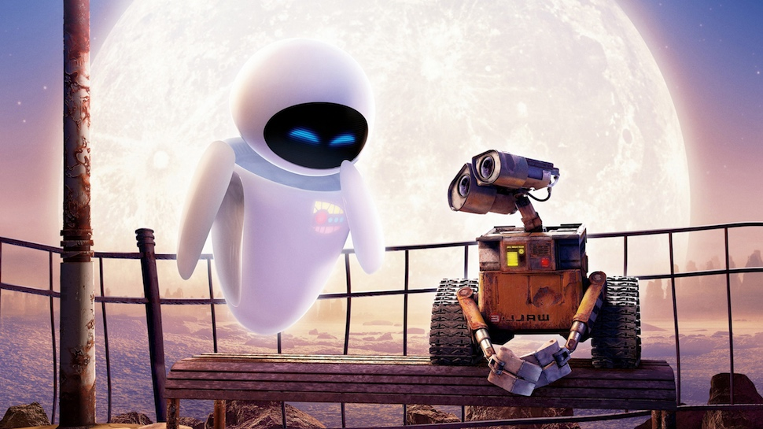
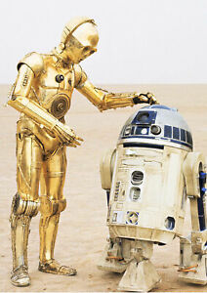
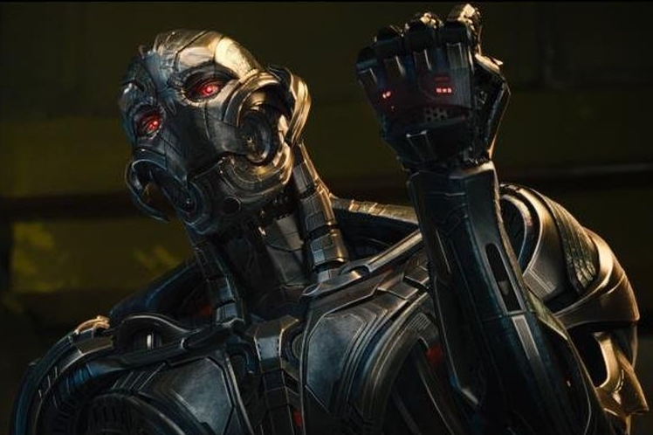
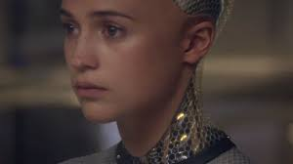
AI in Pop Culture
GLaDOS (Portal)
Agent Smith (Matrix)
T-800 (Terminator)
WALL-E and EVE (WALL-E)
C-3PO and R2-D2 (Star Wars)
Ava (Ex Machina)
HAL 9000 (2001: A Space Odyssey)
Ultron (Marvel)

Slide 6
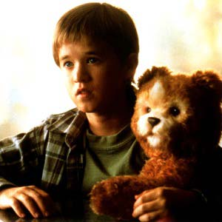
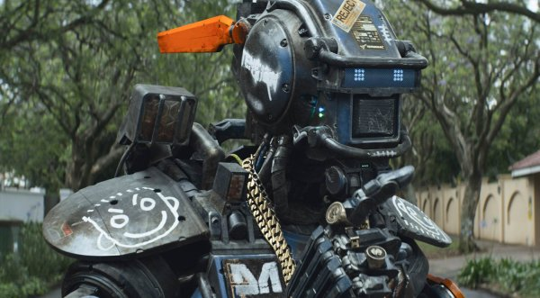


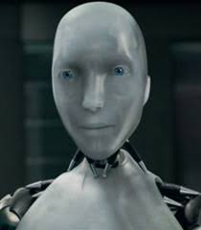

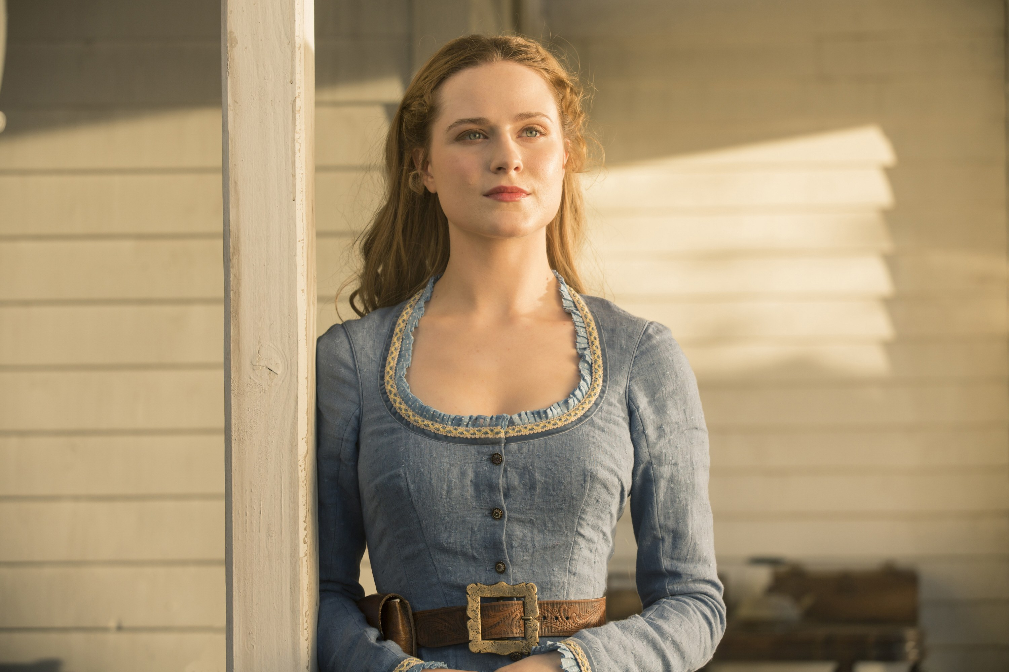
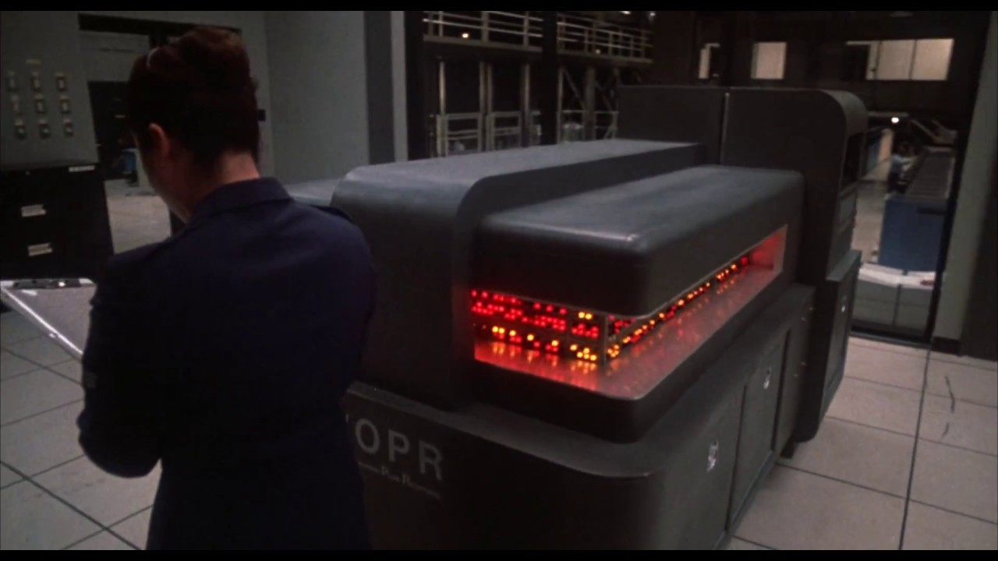
AI in Pop Culture
Samantha (Her)
Roy Batty (Blade Runner)
David (A.I. Artificial Intelligence)
CHAPPiE (Chappie)
Sonny (I, Robot)
WOPR (WarGames)
Andrew (Bicentennial Man)
Dolores (Westworld 2016)

Slide 7

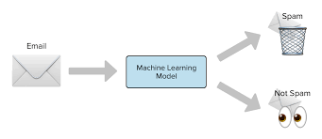

Why should you care about AI?
“Artificial Intelligence is the new Electricity”¹
Artificial Intelligence is transforming industry
It permeates most aspects of technology nowadays
Search engines
Language translation
Spam detection
Personalized marketing and advertising
It could be useful to you
It could be harmful to you
²
1: Andrew Ng https://www.youtube.com/watch?v=CS4cs9xVecg&list=PLkDaE6sCZn6Ec-XTbcX1uRg2_u4xOEky0&index=1
2: https://www.snopes.com/fact-check/hong-kong-protesters-projectors/

Slide 8

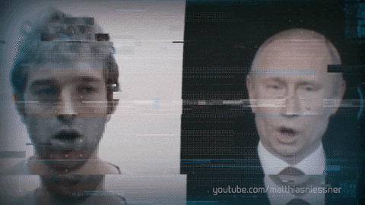
Why should you care about AI?: DeepFake
1: DeepFake: https://lab.witness.org/projects/synthetic-media-and-deep-fakes/

Slide 9
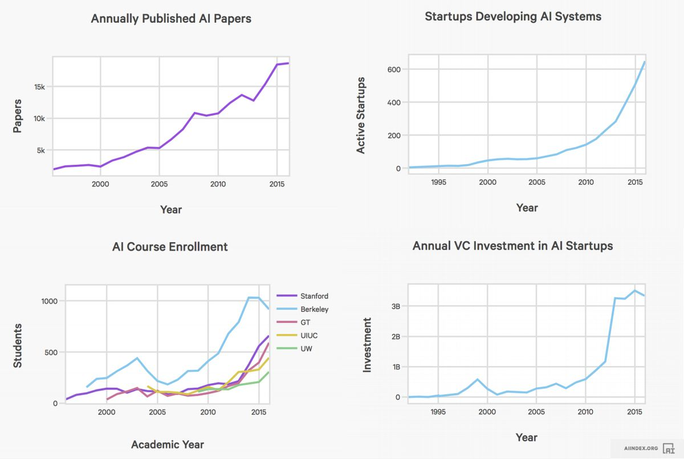
Why should you care about AI?
Graphs from https://www.forbes.com/sites/louiscolumbus/2018/01/12/10-charts-that-will-change-your-perspective-on-artificial-intelligences-growth/#94ee80e47583

Slide 10
Be careful what you read about AI
AI snake oil¹
Obfuscation of facts
Overselling what AI can do
There is a lot of commercial interest in AI these days
Sometimes it’s too good to be true
Sometimes it can be done easily with simpler methods
AI Hype²
The term ‘AI’ is thrown around very loosely
Sometimes it’s not totally autonomous; humans still play an important role
There is always some sort of limitation
Think critically
1: https://www.cs.princeton.edu/~arvindn/talks/MIT-STS-AI-snakeoil.pdf
2: https://www.skynettoday.com/editorials/ai-coverage-best-practices

Slide 11
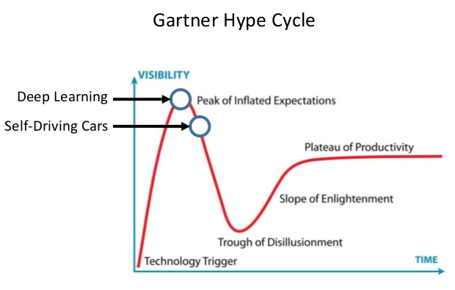
Be careful what you read about AI
1
1: MIT Deep Learning Basics: Introduction and Overview Lex Fridman https://www.youtube.com/watch?v=O5xeyoRL95U

Slide 12
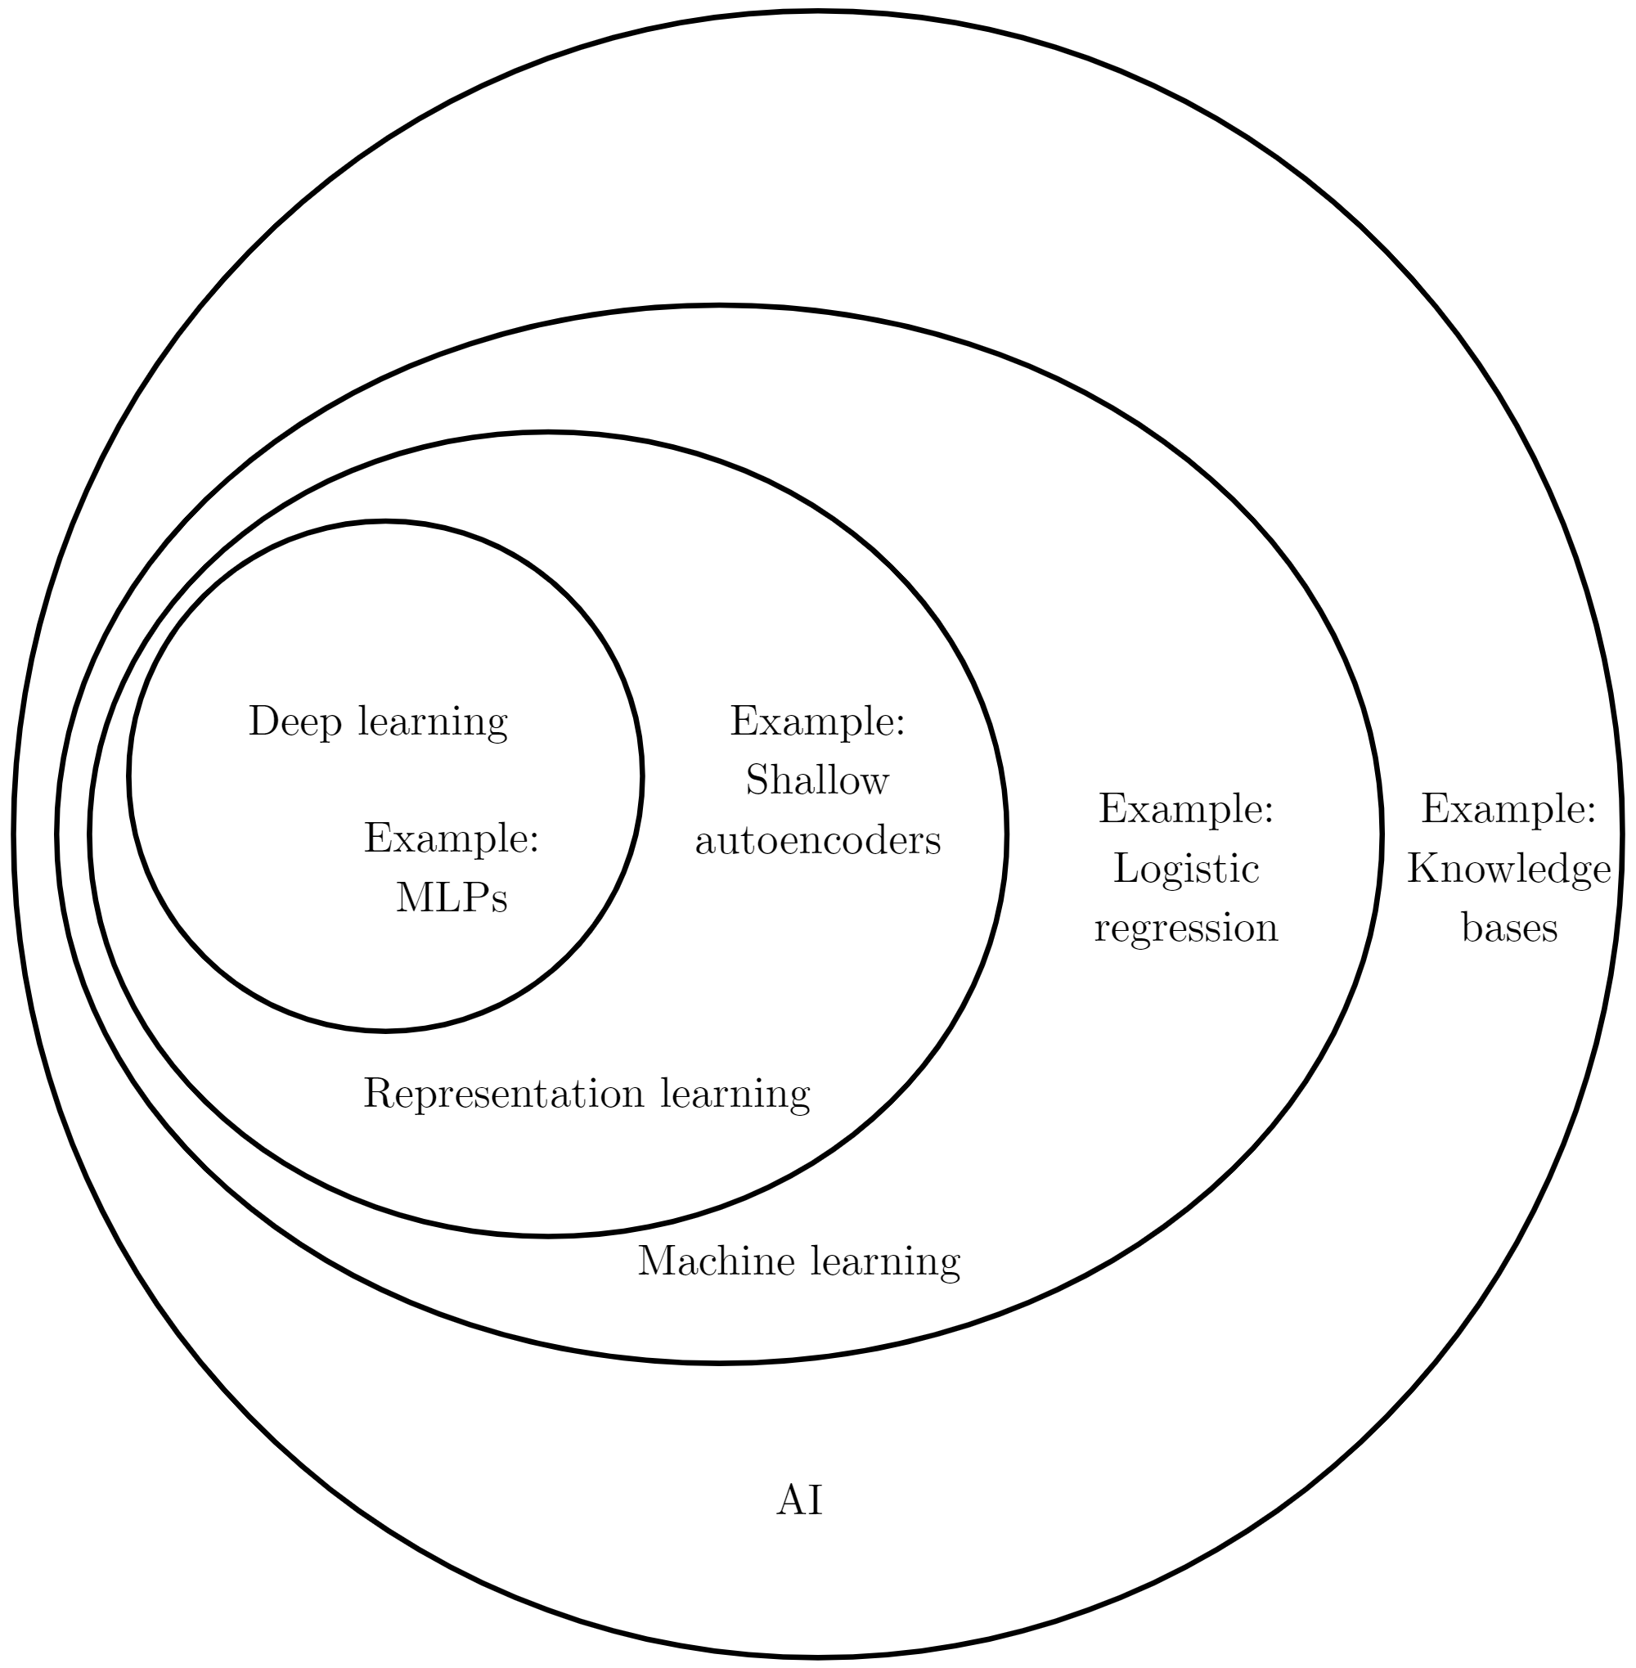
Machine Learning and Artificial Intelligence
AI Venn diagram from http://www.deeplearningbook.org/contents/intro.html

Slide 13
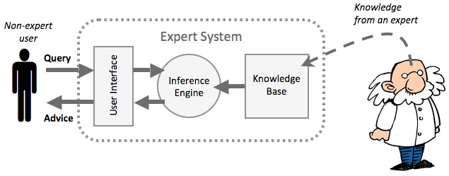
“Classical” AI: Expert Systems
The knowledge base is created from information provided by human experts
1: Expert System Diagram https://www.igcseict.info/theory/7_2/expert/

Slide 14
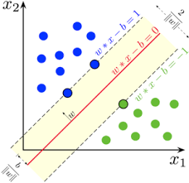
“Traditional” Machine Learning: Support Vector Machines
1: Cortes, Corinna, and Vladimir Vapnik. "Support-vector networks." Machine learning 20.3 (1995): 273-297.

Slide 15
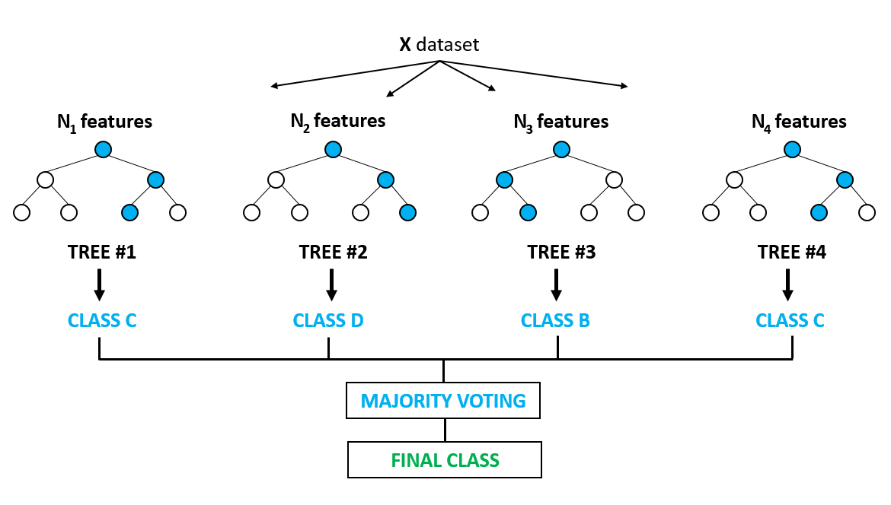
“Traditional” Machine Learning: Random Decision Forest

Slide 16
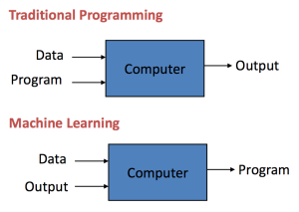
What is Machine Learning?
Defined as: The science of getting computers to learn and act like humans do, and improve their learning over time in autonomous fashion, by feeding them data and information in the form of observations and real-world interactions¹
Deep Learning is a subclass of machine learning which involves the usage of multiple layers of neural networks
1: https://emerj.com/ai-glossary-terms/what-is-machine-learning/

Slide 17
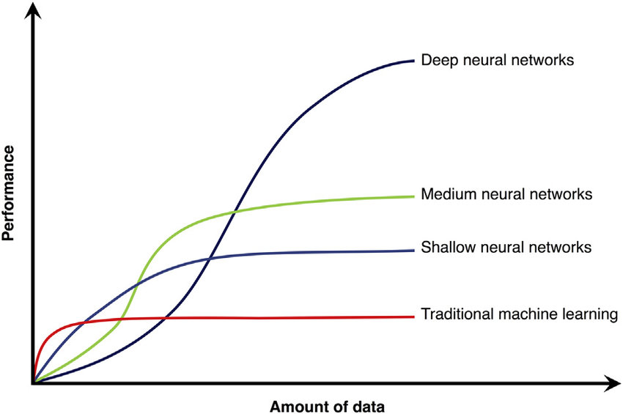
Why Deep Learning?
Reduce time spent programming
Hand coded rules are mostly unnecessary
Customize and scale products
Only need to collect data for new market
Solve seemingly “unprogrammable” tasks
Face recognition and classification
Human pose estimation
Beat the world’s best player at Go
Improvement in computational speed
Better hardware (GPUs)
Data parallelism
Increase in quantity of data
Web services
Mobile apps
Research and industry

Slide 18
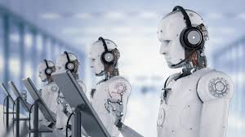
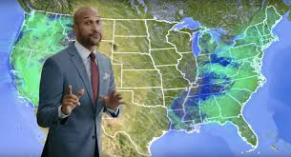
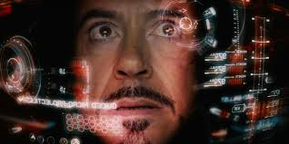
Broad Goals
Automation
Reduce tedious human labour
Improve efficiency
e.g. Algorithm trading, Automatic spam mail detection, Self-driving cars
Solve problems
Solve problems too complex or tedious for humans to solve in a direct manner
Discovery of useful features in complex data
e.g. Translate English to Chinese, Facial detection
Simulation and Modelling
Create models that can accurately predict future events
e.g. Weather prediction, Stock market prediction
Improved tools
Tools that can provide advice with increased precision and rigour
Tools that can reduce risk in dangerous situations
e.g. Computer-aided interpretation of medical images, Disaster relief robots

Slide 19
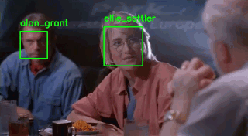
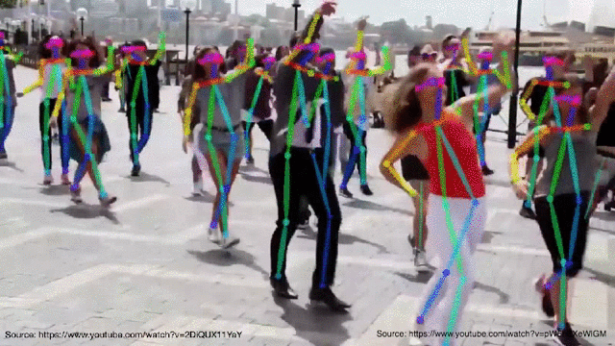

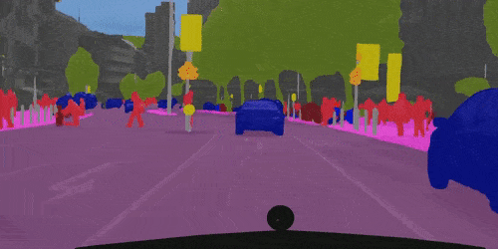
What can Deep Learning do?: Computer Vision

Slide 20
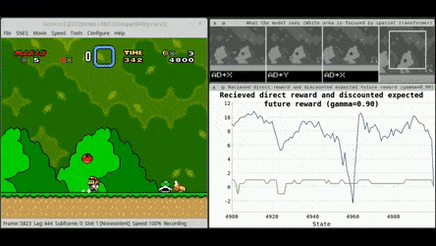
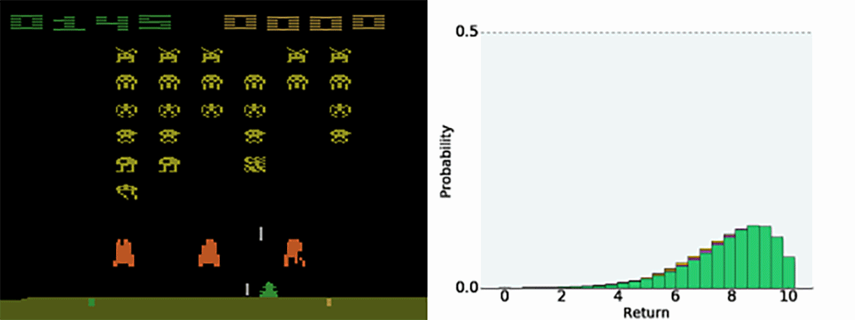
What can Deep Learning do?: Game Playing

Slide 21
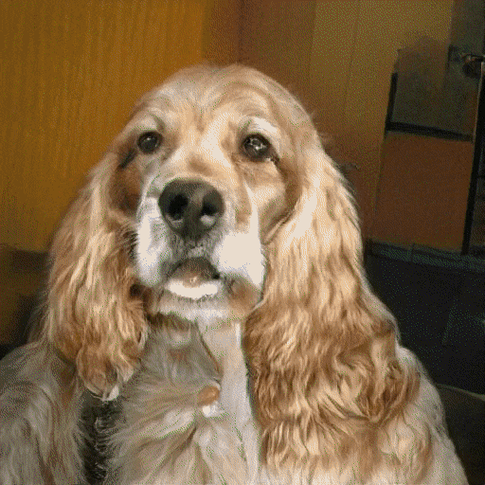
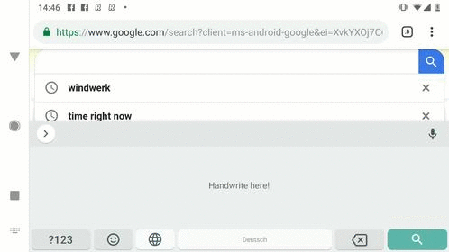
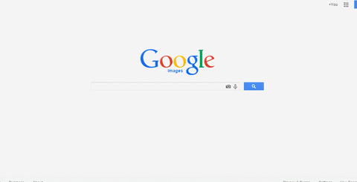
What can Deep Learning do?: Many More!
Handwriting Transcription
Search by Image
Generate fake images

Slide 22
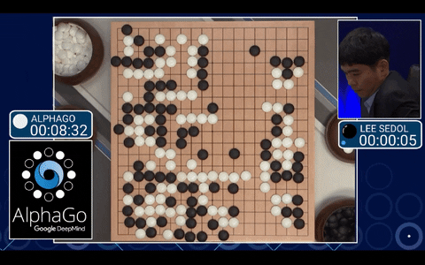
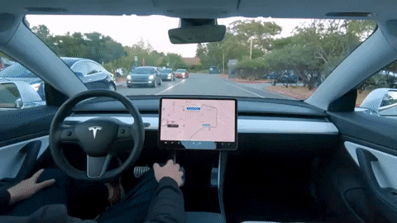
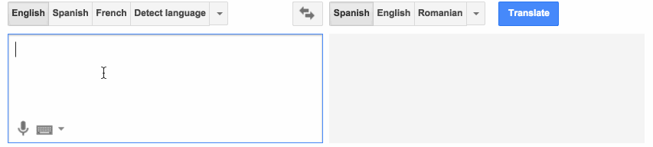
What can Deep Learning do?: Many More!
AlphaGo beats Lee Sedol (2016)
Self-driving car (Tesla)
Machine Translation

Slide 23

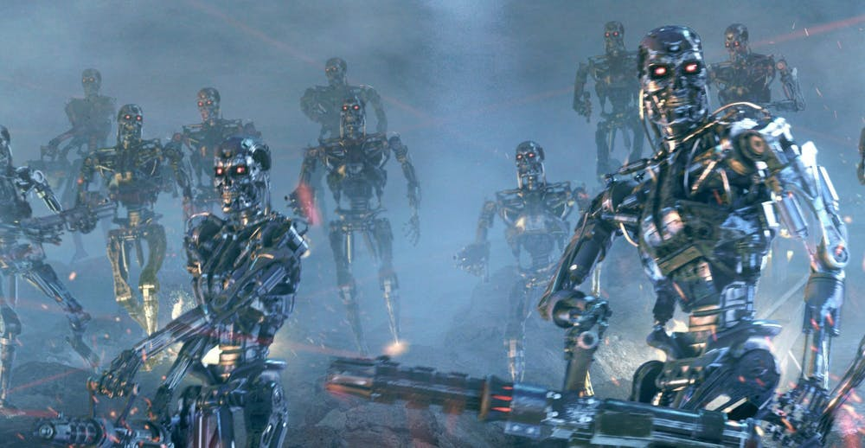
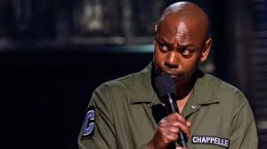
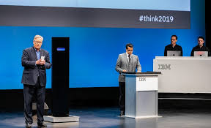
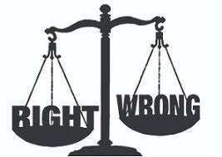
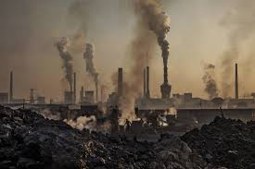
What CAN’T Deep Learning do? (as of 2019)
Love
World domination
Tell intentionally funny jokes
Beat humans at debate¹
(IBM Project Debater)
Make ethical decisions
Save the environment² (?)
1: https://edition.cnn.com/2019/11/21/tech/ai-cambridge-university-debate/index.html
2: https://www.technologyreview.com/s/613630/training-a-single-ai-model-can-emit-as-much-carbon-as-five-cars-in-their-lifetimes/

Slide 24
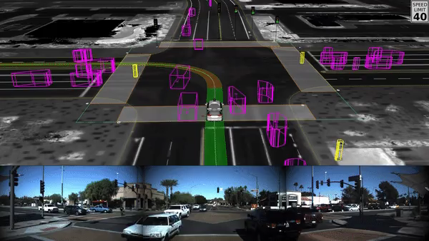
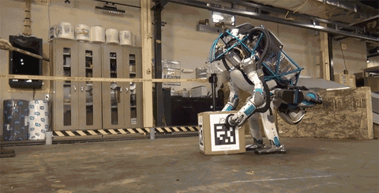
What ISN’T Deep Learning?
Deep Learning is not necessarily used in certain real world applications
Not all autonomous systems, robotics are entirely reliant on Deep Learning
Efforts are being made to improve existing applications with Deep Learning

Slide 25
When to use Deep Learning?
(Rules of thumb) ¹
When you have a lot of data
When you have unstructured data²
e.g. audio signals, images, text
Supervised learning³
This is where AI is most lucrative
Reinforcement learning
Great success has been shown in playing games
Sometimes using classical methods can yield similar or better results
1: Deep Learning is currently in very active research so you can still use it for other problems but there’s no guarantee it will be better than classical methods
2: Structured data works well with both deep learning and classical methods whereas unstructured generally works better with deep learning
3: Unsupervised/Semi-supervised learning has shown success in research but not commercial as far as I know

Slide 26
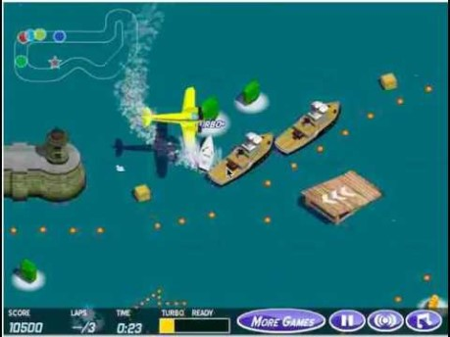
Are Humans Obsolete?
Certain factors in Deep Learning can sometimes lead to unintended consequences¹
Humans are still necessary to ensure the safety and functionality of AI systems
1: MIT Deep Learning Basics: Introduction and Overview Lex Fridman https://www.youtube.com/watch?v=O5xeyoRL95U

Slide 27
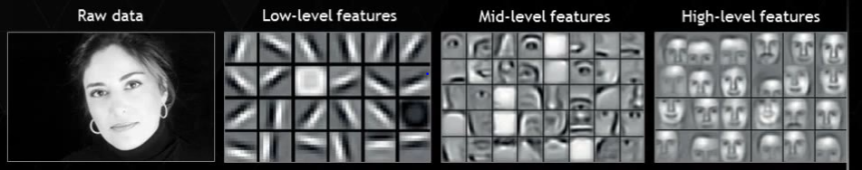
Deep Learning Intuition
Deep Learning is Representation/Feature Learning
CNN
CNN
CNN

Slide 28
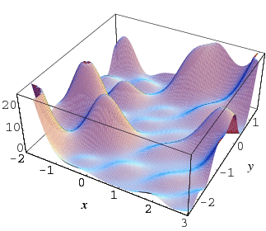
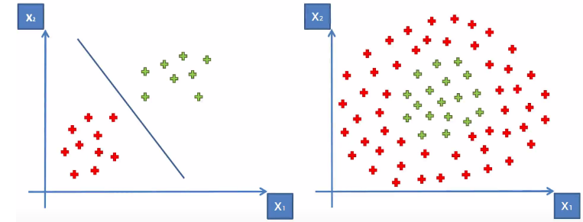
Deep Learning Intuition
We would like to learn a model or function that will give us a desired output given a specific input
Usually these functions will be too complex and highly dimensional for humans to design by hand

Slide 29
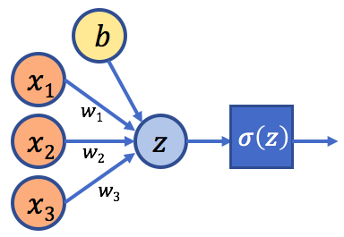
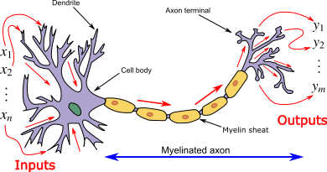

Deep Learning and the Human Brain
Not similar
Artificial Neural Networks are vaguely inspired by biological neural networks
A lot of effort being put in to understand how exactly our brain works

Slide 30
Types of Learning
Supervised Learning
Learn from labelled data (input and target)
e.g. map English sentences to corresponding sentences in Mandarin
Unsupervised Learning
Learn from unlabelled data
e.g. learning important features in data without labels
Self-supervised Learning
Learn from data labelled by extracting information from the input data
e.g. predict future frames in videos
Reinforcement Learning
Learn the optimal decision given the current environment
e.g. playing chess, driving a car

Slide 31

Types of Learning
1: MIT Deep Learning Basics: Introduction and Overview Lex Fridman https://www.youtube.com/watch?v=O5xeyoRL95U

Slide 32

Reinforcement Learning

Slide 33

Learning Tasks: Regression vs Classification

Slide 34


Deep Learning Frameworks
TensorFlow
Developed by Google
Dominant in industry¹
PyTorch
Developed by Facebook
Dominant in research¹
Both
Primarily used with Python
Active development
Free and open source
Flexible libraries
Transferable skills
1: https://thegradient.pub/state-of-ml-frameworks-2019-pytorch-dominates-research-tensorflow-dominates-industry/

Slide 35
Deep Learning Steps: Supervised Learning
Iterate
Iterate
Data Preparation
Training
Evaluation
Deploy
Data collection
Data splitting
Data preprocessing
Normalization
Augmentation
Implementation
Network architecture
Loss function
Optimizer
Hyperparameter tuning
Quantitative
Accuracy
Loss
Qualitative
App
Web service
Embedded system

Slide 36


Data collection
Collect input data and labels
e.g. collect cat and dog pictures online and label cats as 0 and dogs as 1
( , 0)
( , 1)
There are many publicly available datasets online
Collected and released by research groups
e.g Image Classification (ImageNet), Automatic Speech Recognition (LibriSpeech), Object Segmentation (MS-COCO)
Good resources
Kaggle
GitHub
Google Dataset Search

Slide 37

Data preprocessing
Data Cleaning
Remove duplicates
Remove bad labels
Remove redundant data
Data Transformation
Scaling
Normalization
Augmentation
Dimension reduction
Example of image augmentation

Slide 38

Data splitting
Split into training/testing/validation sets
Training set: Training the model
Validation set: Evaluate the model while tuning the model
Testing set: Unbiased final evaluation of the model
Generally you want to have the training set much larger than the testing and validation set
Training set can come from a different distribution from the validation/testing set
e.g. cat pictures from the internet vs cat pictures taken by your phone
The validation and testing set should come from the same distribution
Prevent overfitting!

Slide 39



How do we train the model?
w⁽¹⁾
x
Model
ŷ
1. Forward pass to obtain prediction
2. Calculate error using cost function, J
3. Use backpropagation to calculate gradient
4. Update weights using an optimization algorithm (typically a variant of gradient descent)
$$e = J(w)$$
$\frac{\text{∂}e}{\text{∂}w^{(1)}}$
$w^{(2)}=w^{(1)}−α\frac{\text{∂}e}{\text{∂}w^{(1)}}$

Slide 40









Binary Classification
^{: 0}
^{: 1}
Forward propagation
$$model$$
$$0.85>0.5$$
$σ$(z)
$P(y=1|x)$ = 0.85
$$ŷ=1$$
$$x$$
Loss function: Binary cross-entropy loss

Slide 41

Neural Network
Hidden Layer 1
Input Layer
Hidden Layer 2
Hidden Layer 3
Output Layer
Deep Neural Network from https://developer.oracle.com/databases/neural-network-machine-learning.html

Slide 42

Neural Network
Neural Network GIF from https://www.youtube.com/channel/UCYO_jab_esuFRV4b17AJtAw

Slide 43




Activation Functions
Sigmoid(z) = $\frac{1}{1+e^{−z}}$
Tanh(z) = $\frac{e^{z}−e^{−z}}{e^{z}+e^{−z}}$
x₁
x₂
z
a(z)
ReLU(z) = max(0, z)
Leaky_ReLU(z) = max(0.1z, z)
x₃

Slide 44

Convolutional Neural Network
Convolutional Layer GIF from https://blog.usejournal.com/convolutional-neural-networks-why-what-and-how-f8f6dbebb2f9?gi=3faa9b8cfe4c

Slide 45

Max Pool
Max Pool layer from https://developers.google.com/machine-learning/practica/image-classification/convolutional-neural-networks

Slide 46

Convolutional Neural Network: Putting it all together
Convolutional Network from https://towardsdatascience.com/a-comprehensive-guide-to-convolutional-neural-networks-the-eli5-way-3bd2b1164a53

Slide 47








Optimization: Loss Calculation and Back Propagation
Forward Propagation
predicted
$$model$$
$$0.85>0.5$$
$σ$(z)
$P(y=1|x)$ = 0.85
$$ŷ=1$$
$$x$$
Update model weights
Error
Back Propagation
$$Loss$$
Error Gradient
$$y=1$$
target

Slide 48


Optimization: Gradient Descent
Method to optimize our model and find our optimal weights
We want to find the weights, w that minimize our cost function, J(w)
Currently, there are many variants to improve standard gradient descent
J(w)
$$w_{new}=w_{old} −α\frac{\text{d}J(w)}{\text{d}w}$$
Initial weight, w
$\frac{\text{d}J(w)}{\text{d}w}$
Global minimum
w

Slide 49

Evaluating your Model
Identify how well the model performs
Identify how well the model generalizes to unseen data samples
Quantitative analysis
Use performance metrics
Qualitative analysis
Useful for visual based output

Slide 50

Underfitting and Overfitting
Understanding the model’s ability to generalize to unseen data
High bias
High variance
Underfitting
Good fit
Overfitting
Graphs from https://towardsdatascience.com/underfitting-and-overfitting-in-machine-learning-and-how-to-deal-with-it-6fe4a8a49dbf

Slide 51
Underfitting and Overfitting
Optimal
Cost, J(w)
Underfitting
Overfitting
Validation loss
High bias
High variance
Training loss
Epoch
How do we deal with overfitting? - Regularization

Slide 52


Next Steps
Fix Problems
Is the model performing as expected?
Dataset
Fix mislabeled data
Add more data to cover the worst performing samples
e.g. add more cloudy images
Hyperparameter tuning
Find the best performing model
Regularization
Prevent overfitting
Improving the model
Updating the loss function
Updating the model architecture
Cat?

Slide 53
Multi-class Classification
Machine Learning Research is Iterative
Finding good models is empirical
Research cycle:
Develop algorithm
Implement algorithm and train model
Evaluate model and identify weakness
Repeat until satisfied
Idea
Experiment
Code

Slide 54
Multi-class Classification
Improving Neural Networks
Space
Model size
Model training time
Model performance
Accuracy
Inference speed
Time
Performance

Slide 55

Multi-class Classification
Model Tuning
Tweak the network until we find the configuration that gives us the best performance
Size of network
Number of hidden units
Number of layers
Activation function
Cost function
Optimizer
Weight initialization
Types of layers
Batch size
Learning rate schedule
…. a lot more!

Slide 56

Multi-class Classification
Barrier to Entry
Computational resources
Deep learning research is computationally intensive
Finding a good model requires a lot of iteration
Good GPUs can cost a lot
Datasets
Deep learning models are data hungry
Generally, the more data you have, the better your model will be
Some types of data are not easy to collect¹
Expertise
A lot of resources online makes it easy to learn
In-depth understanding takes some time
Competing with large companies for graduates
1: https://time.com/5518339/china-ai-farm-artificial-intelligence-cybersecurity/

Slide 57
Multi-class Classification
Where are we now?
Most big questions of intelligence have not been answered nor properly formulated¹
Research is happening all over the world
Deep Learning Frameworks are constantly being improved
More industries are adopting deep learning into their systems
We have come a long way and we still have much left to do!
1: MIT Deep Learning Basics: Introduction and Overview Lex Fridman https://www.youtube.com/watch?v=O5xeyoRL95U

Slide 58
Multi-class Classification
Useful Resources
Coursera Deep Learning Specialization by deeplearning.ai
Introductory course to Deep Learning
Good for beginners
Coursera TensorFlow in Practice Specialization by deeplearning.ai
Tutorials on using TensorFlow
PyTorch Tutorials at pytorch.org
Tutorials on using PyTorch
Deep Learning Book by Ian Goodfellow, Yoshua Bengio and Aaron Courville
Introductory textbook on Deep Learning
GitHub
Code examples
Datasets
Quora or Stack Overflow
Asking questions
Lex Fridman Youtube Channel
Podcasts
Lectures
Deep Learning is really big now so there’s a lot of resources out there if you search for it!

Slide 59
Questions?

